Slide 1
Impact of weather on travel, crime and accidents in Brazil

Slide 2
Abstract
During times of heightened travel and tourism, our intuition suggests that there would be an increase in road accidents as well as criminal activity owing to the increase in tourism.
The aim of this project is to understand whether such a correlation exists and if so, can we help Brazilian authorities be better prepared for handling such a surge.

Slide 3
Motivation
Our purpose is to assist the Brazilian authorities be better prepared to handle road accidents and criminal activity during times of increased travel.
This would ultimately lead to an increase in the quality of life for the people of Brazil.

Slide 4
Goodness
Necessary extreme and erroneous value exclusion. (eg. temp = -9999)
Tableau is used for visualization.
Linear Regression is used to draw conclusion on positive & negative effects.

Slide 5
Data Sources
Brazil Weather Data
Hourly Climate data from 122 weather stations between 2000 and 2021.
10 GB
Crime Data in Brazil
All crime data for 10 years of police work in the biggest city of South America
130.5 MB
Brazil Highway Traffic Accidents
Highway Accident dataset collected by Federal Police of Brazil from year 2007 to year 2021 grouped by the State and Municipal area codes.
473MB
Brazil Interstate Bus Tickets
Bus tickets sales for all interstate brazilian bus travels in 01-2020, 03/11/12-2019 .
2.8GB

Slide 6
Data Sample - Weather
Index, Date (YYYY-MM-DD),Time (HH:00),Amount of precipitation in millimetres (last hour),Atmospheric pressure at station level (mb),Maximum air pressure for the last hour (mb),Minimum air pressure for the last hour (mb),Solar radiation (KJ/m2),Air temperature (instant) (°c),Dew point temperature (instant) (°c),Maximum temperature for the last hour (°c),Minimum temperature for the last hour (°c),Maximum dew point temperature for the last hour (°c),Minimum dew point temperature for the last hour (°c),Maximum relative humid temperature for the last hour (%),Minimum relative humid temperature for the last hour (%),Relative humid (% instant),Wind direction (radius degrees (0-360)),Wind gust in metres per second,Wind speed in metres per second,Brazilian geopolitical regions, State (Province),Station Name (usually city location or nickname),Station code (INMET number),Latitude,Longitude,Elevation
38999,2017-12-20,15:00,0.0,899.2,899.6,899.2,3306,26.6,16.7,26.7,25.4,17.9,16.0,60,52,54,55,8.3,3.4,CO,DF,PARANOA (COOPA-DF),A047,-16.01111111,-47.5575,1043.0 139000,2017-12-20,16:00,0.0,898.6,899.2,898.6,3167,27.3,15.8,27.6,25.9,17.1,14.5,56,45,49,62,8.3,3.6,CO,DF,PARANOA (COOPA-DF),A047,-16.01111111,-47.5575,1043.0 139001,2017-12-20,17:00,0.0,897.7,898.6,897.7,3279,27.5,12.9,28.5,26.6,17.6,12.9,53,41,41,43,6.7,3.1,CO,DF,PARANOA (COOPA-DF),A047,-16.01111111,-47.5575,1043.0 139002,2017-12-20,18:00,0.0,897.0,897.7,897.0,2753,27.5,13.7,28.9,27.4,15.6,12.4,45,39,43,98,6.4,3.5,CO,DF,PARANOA (COOPA-DF),A047,-16.01111111,-47.5575,1043.0 139003,2017-12-20,19:00,0.0,896.3,897.0,896.3,2140,28.4,13.5,28.6,27.4,14.9,12.1,46,36,40,67,6.4,2.9,CO,DF,PARANOA (COOPA-DF),A047,-16.01111111,-47.5575,1043.0 139004,2017-12-20,20:00,0.0,895.8,896.3,895.8,1545,27.7,13.8,28.4,27.5,15.1,12.1,45,38,42,112,5.8,3.1,CO,DF,PARANOA (COOPA-DF),A047,-16.01111111,-47.5575,1043.0 139005,2017-12-20,21:00,0.0,896.1,896.1,895.7,692,26.2,12.4,27.7,26.1,15.1,12.1,47,39,42,113,5.6,2.3,CO,DF,PARANOA (COOPA-DF),A047,-16.01111111,-47.5575,1043.0

Slide 7
Data Sample - Bus Tickets
2486967;30069314000101;35191230069314002821;000370123;03-12-2019;14:31:00;Interestadual;08008031;SAO PAULO(SP) - RIO DE JANEIRO(RJ);SAO PAULO/SP ;RIO DE JANEIRO/RJ ;Convencional com sanitᲩo;13-01-2020;00:15:00;Regular;23;08;Tarifa Normal - sem desconto;109.77;0.00;12.00;7.83;6.39;123.99;NSe Aplica;NÏ
2514696;30069314000101;35200130069314002821;000467165;18-01-2020;10:52:00;Interestadual;08008031;SAO PAULO(SP) - RIO DE JANEIRO(RJ);SAO PAULO/SP ;RIO DE JANEIRO/RJ ;Convencional com sanitᲩo;20-01-2020;13:30:00;Regular;42;02;Tarifa Normal - sem desconto;113.68;0.00;12.00;7.83;6.39;127.90;NSe Aplica;NÏ
2487811;30069314000101;35200130069314002821;000466270;17-01-2020;19:12:00;Interestadual;08008031;SAO PAULO(SP) - RIO DE JANEIRO(RJ);SAO PAULO/SP ;RIO DE JANEIRO/RJ ;Convencional com sanitᲩo;18-01-2020;00:35:00;Regular;50;06;Tarifa Normal - sem desconto;113.68;0.00;12.00;7.83;6.39;127.90;NSe Aplica;NÏ
2515155;30069314000101;35200130069314002821;000474390;22-01-2020;13:10:00;Interestadual;08008031;SAO PAULO(SP) - RIO DE JANEIRO(RJ);SAO PAULO/SP ;RIO DE JANEIRO/RJ ;Convencional com sanitᲩo;22-01-2020;23:55:00;Regular;21;04;Tarifa Normal - sem desconto;113.68;0.00;12.00;7.83;6.39;127.90;NSe Aplica;NÏ
- travel code, company cnpj,Serial number of fiscal equipment,Ticket number,Date of ticket issuance,Ticket issuance time,Transport category (international, interstate), **Line number,** Line origin,**Place of origin of the passenger's trip,** **Destination location of the passenger's trip,** Type of service purchased, **Travel date,** **Travel time,** Type of trip (regular or extra),Seat number,Departure platform number, Indicates the reason for the discount/gratuity, Rate value without considering discounts(Price?), Percentage of discount applied, if any Value of the ICMS rate applied to the tariff,Toll amount to be added to the fare, if any,*Value of the boarding tax, if any.**Ticket value paid by the user.*Ticket purchase method (in person, internet or onboard).Whether the ticket was canceled (yes or no).

Slide 8
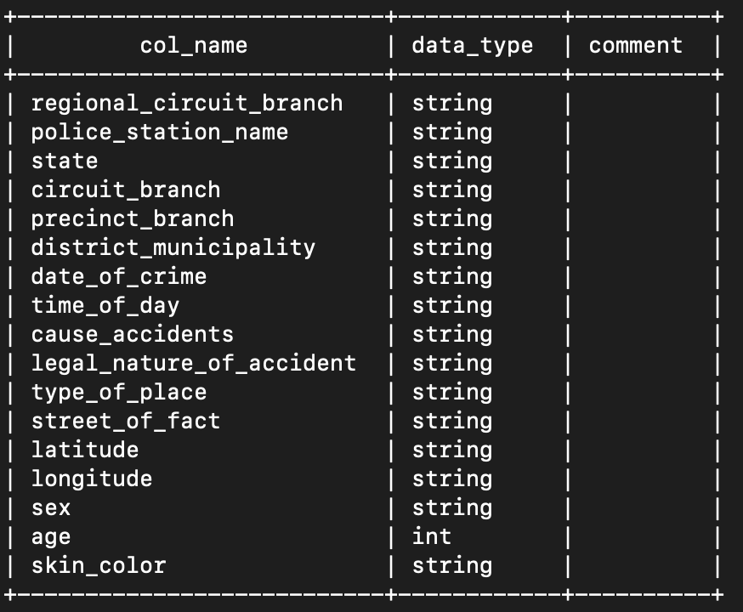
Data Sample - Crime
DIV.POL.PORTO/AERO/PROT.TURIS-DECADE,06º D.P. METROPOLITANO,S.PAULO,DEL.SEC.1º CENTRO,08º D.P. BRAS,S.PAULO,04/01/2016,18:15,Consumado,"Furto qualificado (art. 155,§4o. Se o crime é cometido:,Metrov. e ferroviário metrop.-vagão,0,-23.545101,NULL,F,30,Preta
DIV.POL.PORTO/AERO/PROT.TURIS-DECADE,06º D.P. METROPOLITANO,S.PAULO,DEL.SEC.2º SUL,35º D.P. JABAQUARA,S.PAULO,05/01/2016,12:30,Consumado,Roubo (art. 157),Terminal/Estação,ESTAÇÃO METRO JABAQUARA,-23.64611143,-46.64074252,F,34,Branca
DIV.POL.PORTO/AERO/PROT.TURIS-DECADE,06º D.P. METROPOLITANO,S.PAULO,DEL.SEC.1º CENTRO,03º D.P. CAMPOS ELISEOS,S.PAULO,11/01/2016,22:30,Consumado,Roubo (art. 157),mediante grave ameaça ou violência a pessoa",Metrov. e ferroviário metrop.-outros,0,-23.5431853,NULL,M,34,Parda
DIV.POL.PORTO/AERO/PROT.TURIS-DECADE,06º D.P. METROPOLITANO,S.PAULO,DEL.SEC.1º CENTRO,01º D.P. SE,S.PAULO,21/01/2016,19:00,Consumado,Roubo (art. 157),Terminal/Estação,ESTAÇÃO METRO PEDRO II,-23.54988579,-46.62676287,M,33,Branca
Key columns:
State, district_municipality, date_of_crime, time_of_day, sex, age, skin_color,

Slide 9
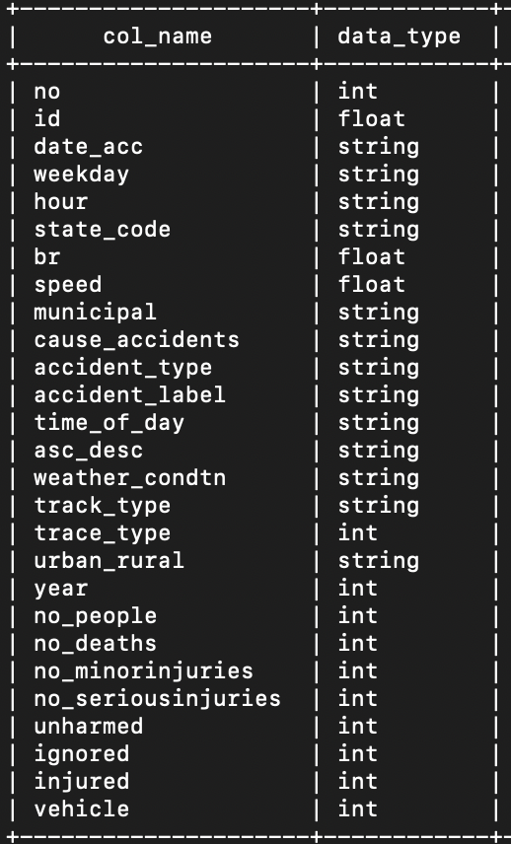
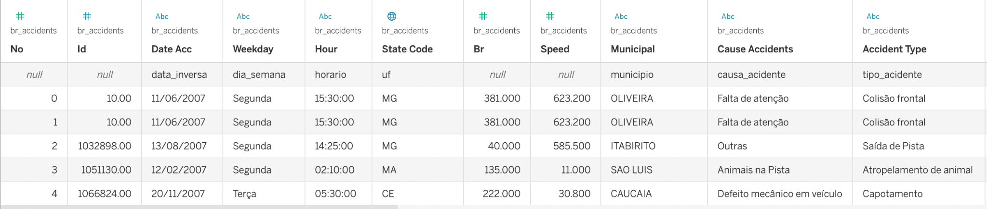
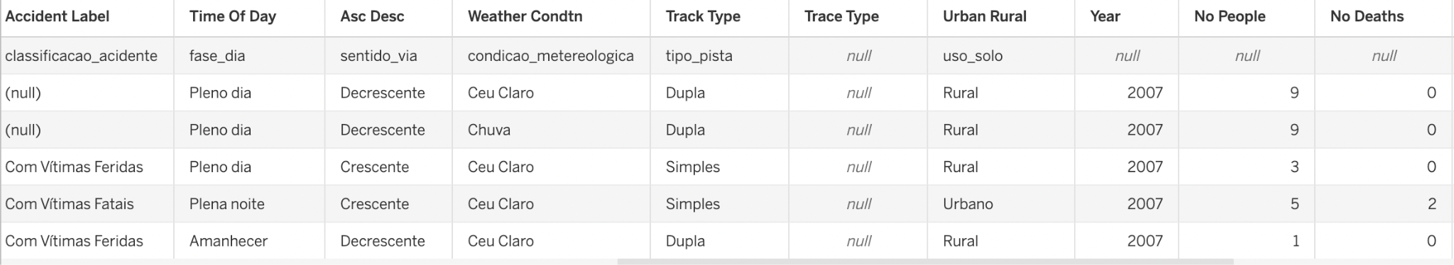
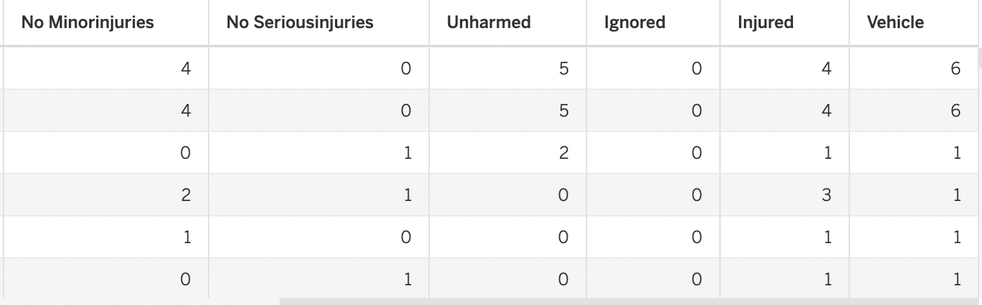
Data Sample - Accidents

Slide 10
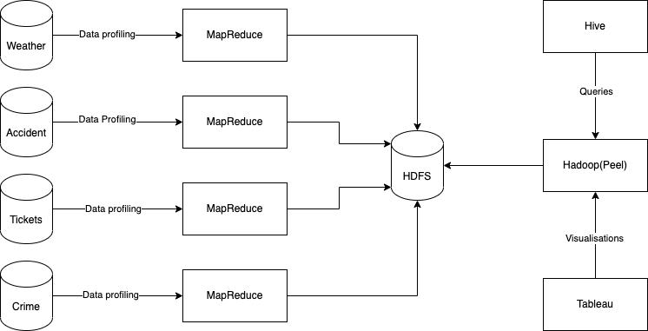
System Design

Slide 11
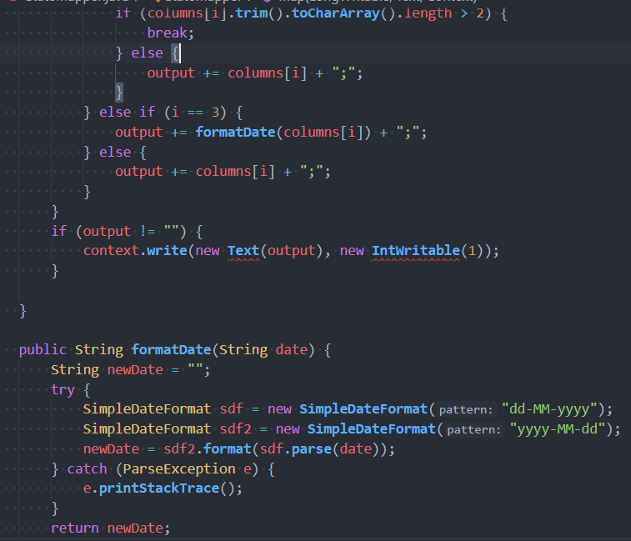
Code Challenge 1 - Date Formatting
Standard format chosen: yyyy-MM-dd All datasets had different date formats, some had date split into multiple columns. These had to be converted for ease of use later.

Slide 12
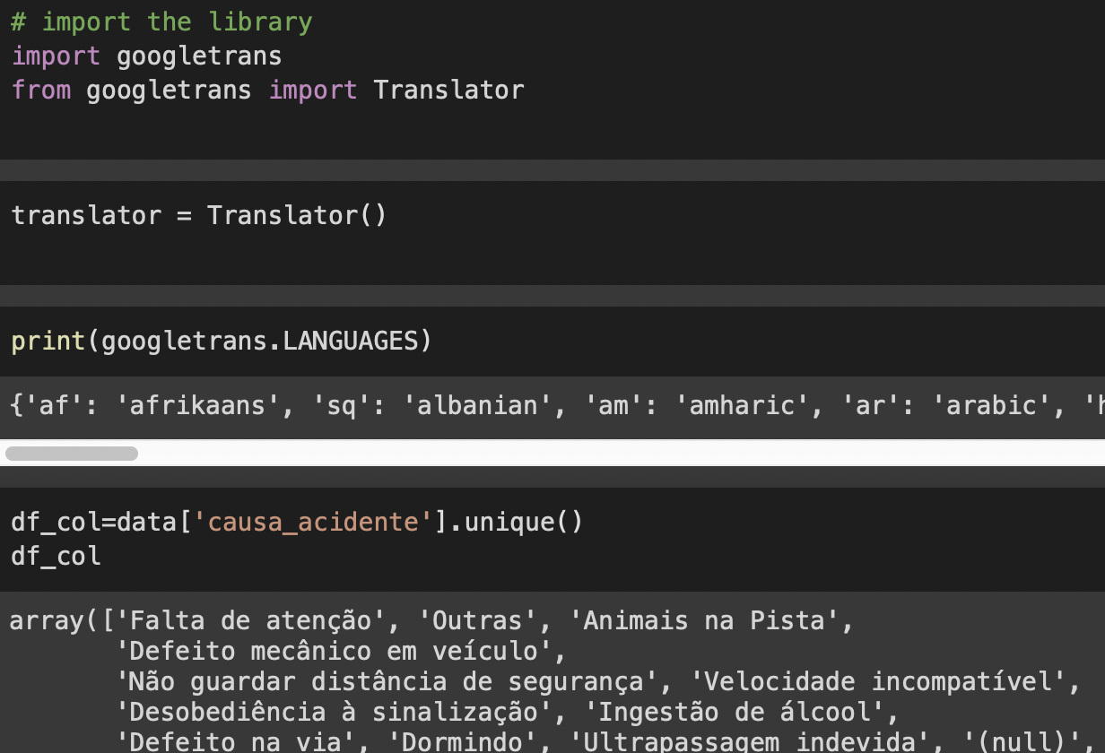
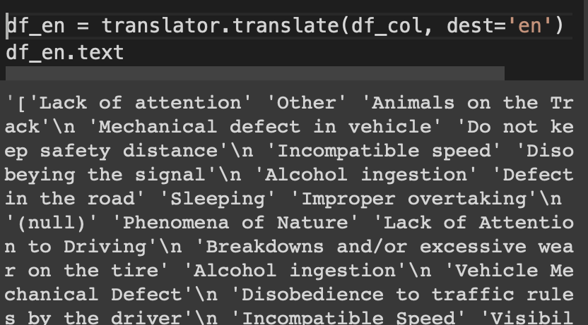
Code Challenge 2 - Translations
Cause of Accident in Highway data was in Portuguese.
Translated to English using the Google Translate API.
Translated

Slide 13
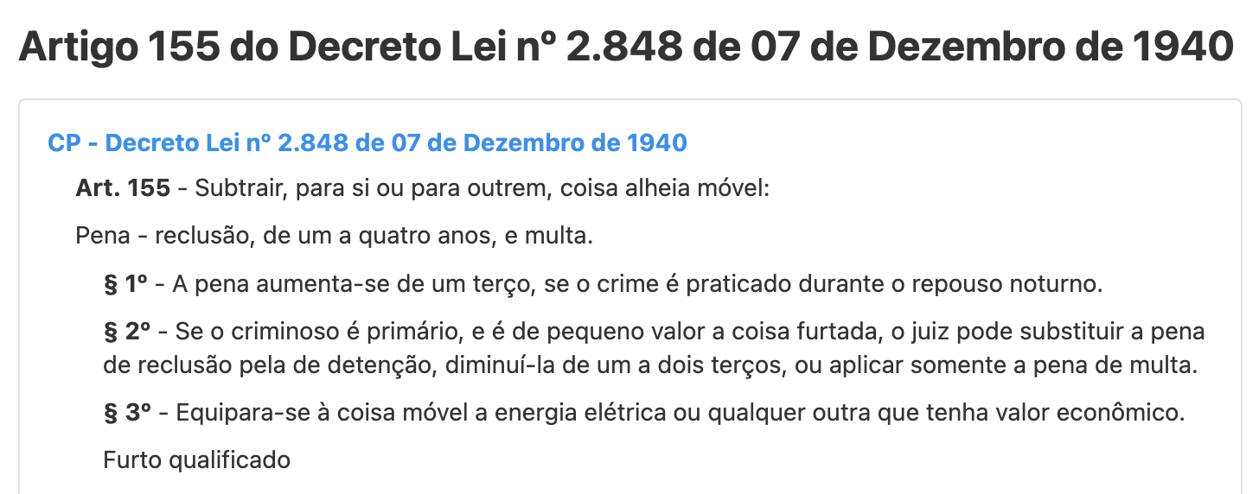
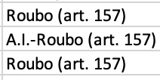
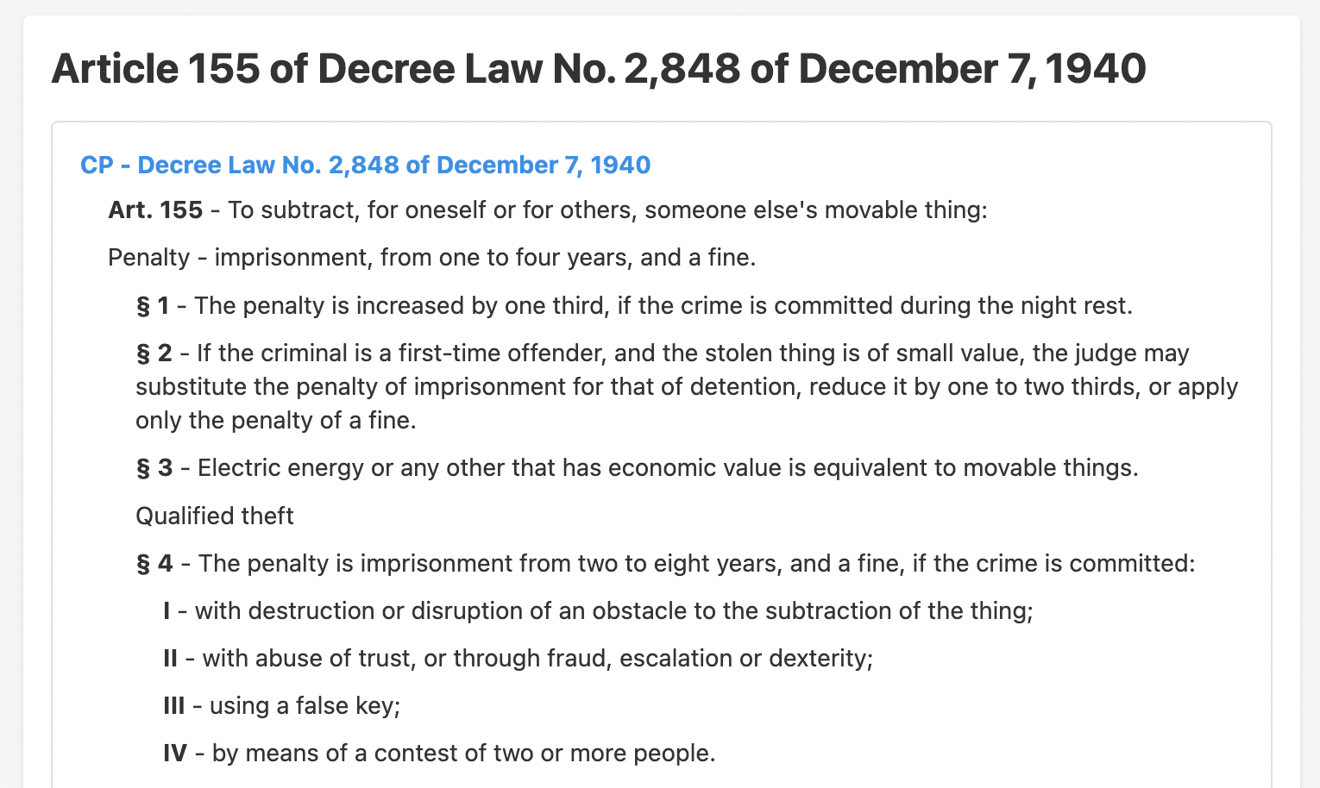
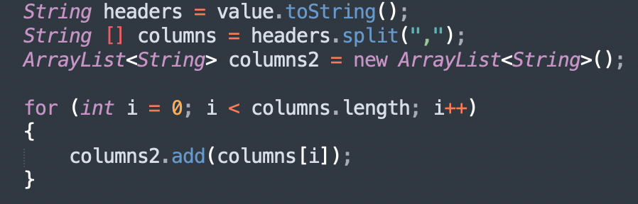

Code Challenge 3 - Getting meaningful values
Translating data from Portuguese
Using Google translate API
Understanding each crime’s legal implications
Leveraging the right data structure to store values
3. Combining all outputs into 1 using: -getmerge

Slide 14
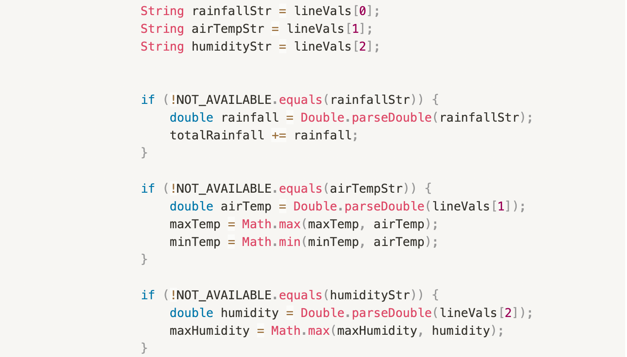
Code Challenge 4 - Bad Data Removal
International travel from the interstate bus ticket dataset. Ignoring error values while calculating daily average temperature/ rainfall/ humidity.

Slide 15
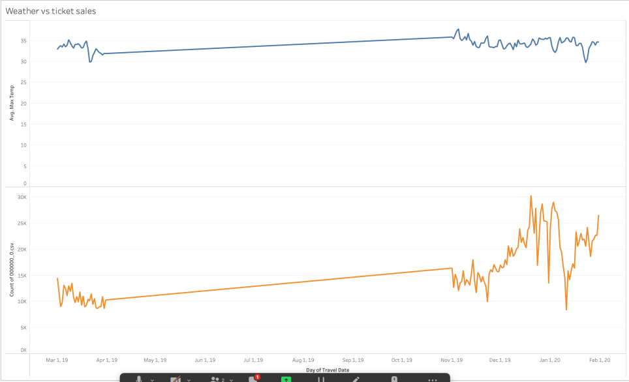
Result-1
Interstate traveling is not influenced by weather, rather it is seasonal in nature and largely occurs around the holiday seasons."
Possible reason: → Travel is seasonal
Counts = 394.687*(Avg Max Temperature)+3534.8
Fitting error:
0.07654148117321648

Slide 16
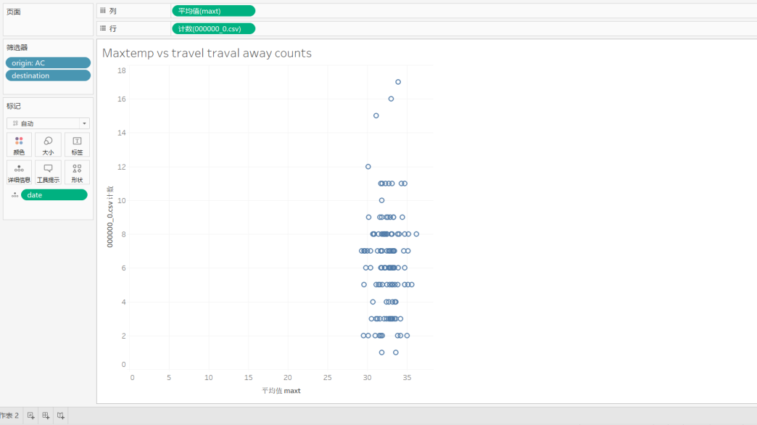
Result-2
Also, high temperature in one state does not necessarily mean people leave the state. AC: Acre
Possible reason: → Planning Ahead
→ Planning Ahead
F(x) = 0.0412x+4.970680061211489
Which means there's hardly any influence.

Slide 17
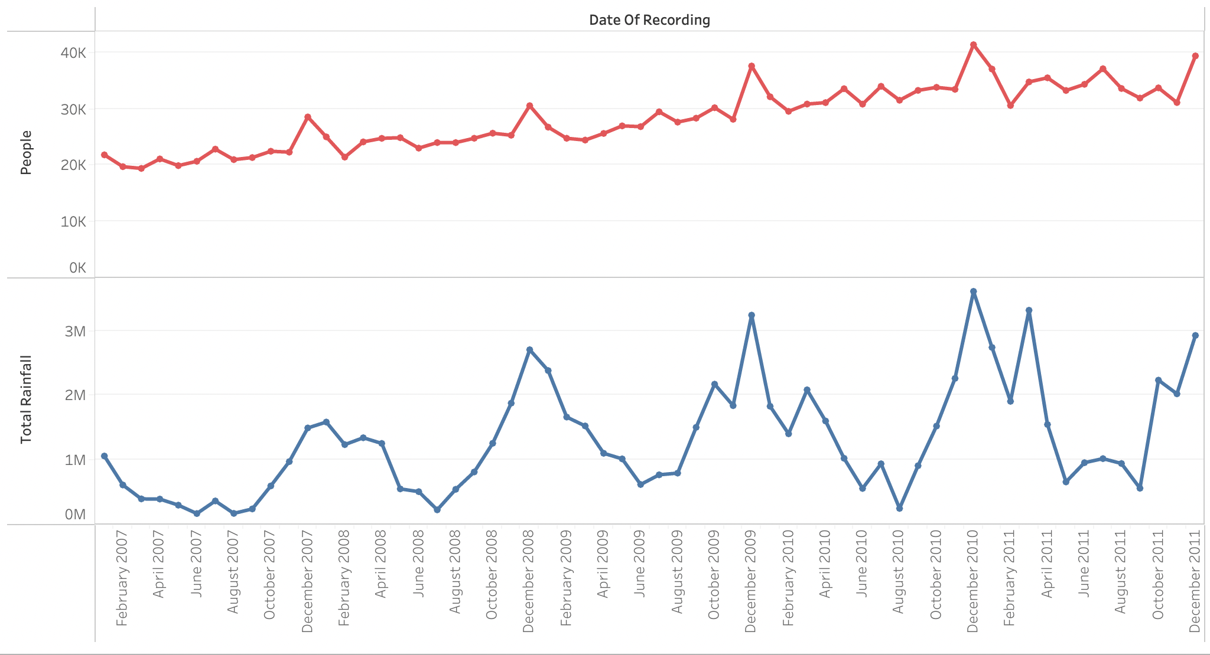
Result-3
An increase in rainfall leads to more Highway accidents. As can been seen by the positive correlation between “Total Rainfall” and “Number of deaths”.
→ Possible reasons:
→ Reduced visibility
→ Slippery roads
Correlation coefficient (r) = 0.62060776656665
Regression line equation: y = 97.232x - 1454783.603

Slide 18
Challenges
→ Understanding our data:
Translating from portuguese to english
Comprehending Brazil’s systems and geography (e.g. nature of car accidents are unique to Brazil’s peculiar landscapes)
Contextualizing the data (e.g. The use of local colloquialism in crime scene reports)
→ Joining data across datasets
Dates – dates and time inconsistent across datasets
States - state data was in different formats across datasets

Slide 19
Summary
We saw that although weather doesn’t have a strong correlation with demand in travel, bad(low visibility/rainfall) weather does increase the number of road accidents that take place.
To ensure quality of our analysis, we use MapReduce to profile the data, Hive to combine multiple datasets and Tableau to visualize the results.
We also performed linear regression to calculate the relevance so we can have a brief estimation in similar situations.

Slide 20
Acknowledgements
Dataset Sources: Kaggle
NYU HPC
Tableau for student license Google Translate

Slide 21
References
Brazil Highway Traffic Accidents https://www.kaggle.com/datasets/mcamera/brazil-highway-traffic-accident
Climate Weather Surface of Brazil https://www.kaggle.com/datasets/PROPPG-PPG/hourly-weather-surface-brazil-southeast-region
Brazil Interstate Bus Tickets https://www.kaggle.com/datasets/danlessa/brazil-interstate-bus-travels
Crime Data in Brazil https://www.kaggle.com/datasets/inquisitivecrow/crime-data-in-brazil

